Slide 1
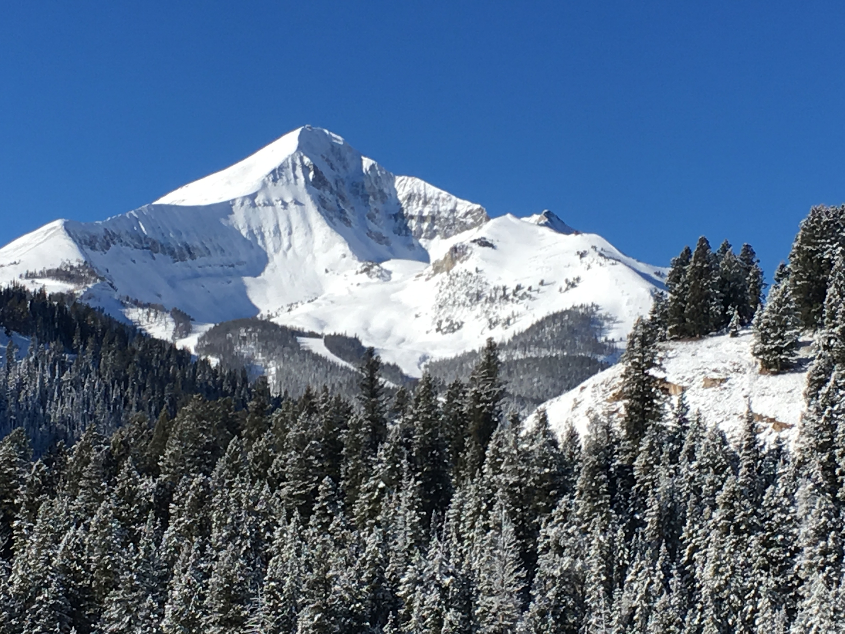
Aging Well In Big Sky
Survey Results
February – March 2026

Slide 2
124 answered

Slide 3
124 answered

Slide 4
81 answered

Slide 5
111 answered

Slide 6
